Slide 1
Research PRACTICE
COMP320
Statistical Data Analysis I

Slide 2
False Discovery & Replicability
When we make claims as researchers, we are often subject to error and so replication is important:
 |  | Reality
 |  | True | False
Decision | Accept Claim | Good Decision | Type-1 Error (“False Positive”)
 | Reject Claim | Type-2 Error (“False Negative”) | Good Decision

Slide 3
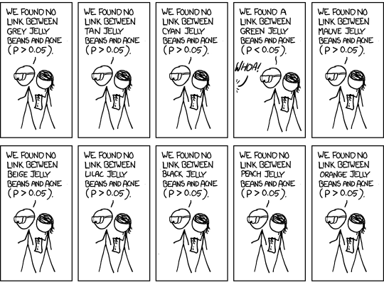
False Discovery & Replicability

Slide 4
False Discovery & Replicability
An alternative to replication is to use a larger dataset and to assess multiple hypotheses with reasonable adjustment. For example:
Benjamini Hochberg Used in multiple hypothesis testing on the same dataset
Bonferroni Used for multiple group comparisons using the same dataset

Slide 5
Common Statistical Tests
Use in your Dissertations

Slide 6
Research Questions
Researchers often want to know if there is a significant relationship between two variables
How strong is the relationship between login queue waiting time and player satisfaction?
Does an increase in in-game prompts correspond to an increased number of in-game micro transactions?
Is there a relationship between employees’ levels of stress and talent retention?
Does age predict play-style?

Slide 7
Research Questions
Or if there is a difference between one or more scores/conditions/groups
Is game-0 selling more copies than game-1 in the UK?
Does working in pairs improve programming performance?
Has allowing programmers to work from home decrease game development productivity?
Has the new character caused a significant disruption to game balance in terms of win/loss ratio?
Is there a difference in the way male and female players interact with costume-orientated micro transactions in an MMORPG?

Slide 8
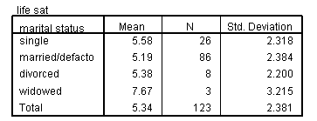
Statistical tests: Why we need them?
Does marital status affect play?
‘In a scale from 1 to 8, how often do you play games?’
Great! I found a difference!!
How confident are you? Is it an accident (due to chance)?
We need to have a statistical test to make the inference!

Slide 9
Choosing the right test
If you browse any introductory statistics text book you’ll find a bewildering array of different statistical tests
Each has:
a specific purpose (i.e. exploring relationships, comparing groups)
Assumptions and data requirements (categorical, ordinal or continuous data, normal distribution)
Most of the well known tests are very easy to run in R
However, it is critically important to be able to
Select the most appropriate test given your research question
Understand conceptually what the test is computing
Effectively interpret the output

Slide 10
Step 1: What is your question?
Remember, when conducting research it is important to be clear about the questions you are trying to answer…ideally before you begin data collection
The questions...
Does an increase in in-game prompts correspond to an increased number of in-game micro transactions?
Is there a relationship between employees’ levels of stress and talent retention?
...require quite different statistical tests to questions like:
Is game-0 selling more copies than game-1 in the UK?
Has allowing programmers to work from home decrease game development productivity?

Slide 11
Step 2: Select your data
Which variables will you be using?
Which is the independent variable (IV)?
The variable that is believed to affect the dependent variable
What you control/manipulate
Which is the dependent variable (DV)?
The observation that is believed to be affected by the IV
What you measure (aka outcome variable)
Identify the IV and DV in the following questions:
Does gender affect product ratings?
Does revision time affect test scores?
Does the website background colour influence reading speed?
Which type of interface results in higher user satisfaction?

Slide 12
Step 2: Select your data
What is the level of measurement for each variable?
Categorical or continuous?
Examples of categorical variables?
Examples of continuous variables?

Slide 13
Step 3: Describe your data
Descriptive statistics should be used to define the characteristics of your data (last lecture)
For categorical variables you need to know if numbers in each group/category are balanced
(e.g. Reliable comparison of gender effect not possible if 25 males and only 3 females)
For continuous variables you need to know if the distribution is normally distributed (e.g. Not skewed)

Slide 14
Relationships vs. Difference
Analysing relationships:
Correlation – are continuous variables, X and Y, related?
Pearson’s rho for normally-distributed ratio data
Spearman’s rank correlation for non-normal or interval data
Chi-square – is there an association between two categorical variables.
Useful for inferring differences between groups on discrete measures
Also used for ‘goodness of fit’ tests when comparing matricies
Regression – does the ‘level’ of X predict the ‘level’ of Y?
OLS regression for continuous data with normally distributed residuals
Logistic regression used for discrete data, based on probability of belonging
Flexible, can re-code some nominal/ordinal data as binary values

Slide 15
Relationships vs. Difference
Analysing differences:
T-tests - differences between two groups (e.g. experienced, inexperienced) according to some continuous variable (e.g. score)
Mann-Whitney U Test – based on ranks, lower power but more robust and can compare two groups with non-normal data.
Analysis of Variance (ANOVA) measure differences when there are more than two groups.
Kruskal-Wallis H Test – like Mann-Whitney U, but for multiple groups.
Analysis of Co-variance (ANCOVA) measure differences when there are more than two groups and/or continuous predictors.
Essentially, combines ANOVA with regression.
MANOVA/MANCOVA – multivariate versions for more than one dependent variable.

Slide 16
Import Data Into R
Prepare for Analysis

Slide 17
Import Data into R
Download and examine
https://www.dropbox.com/s/6x44olpr3kwdkkh/obfuscated_data.csv?dl=1

Slide 18
Import Data into R
To import data from a pre-prepared CSV file, use the following command. Note: Requires the Rcpp module. Run Rstudio in admin mode to install if not available.
> library(readr)
> dat <- read_csv("E:/Stats/obfuscated_data.csv")
To view the data use:
> View(dat)
To see the descriptive statistics for all of the variables in the data use:
> summary(dat)

Slide 19
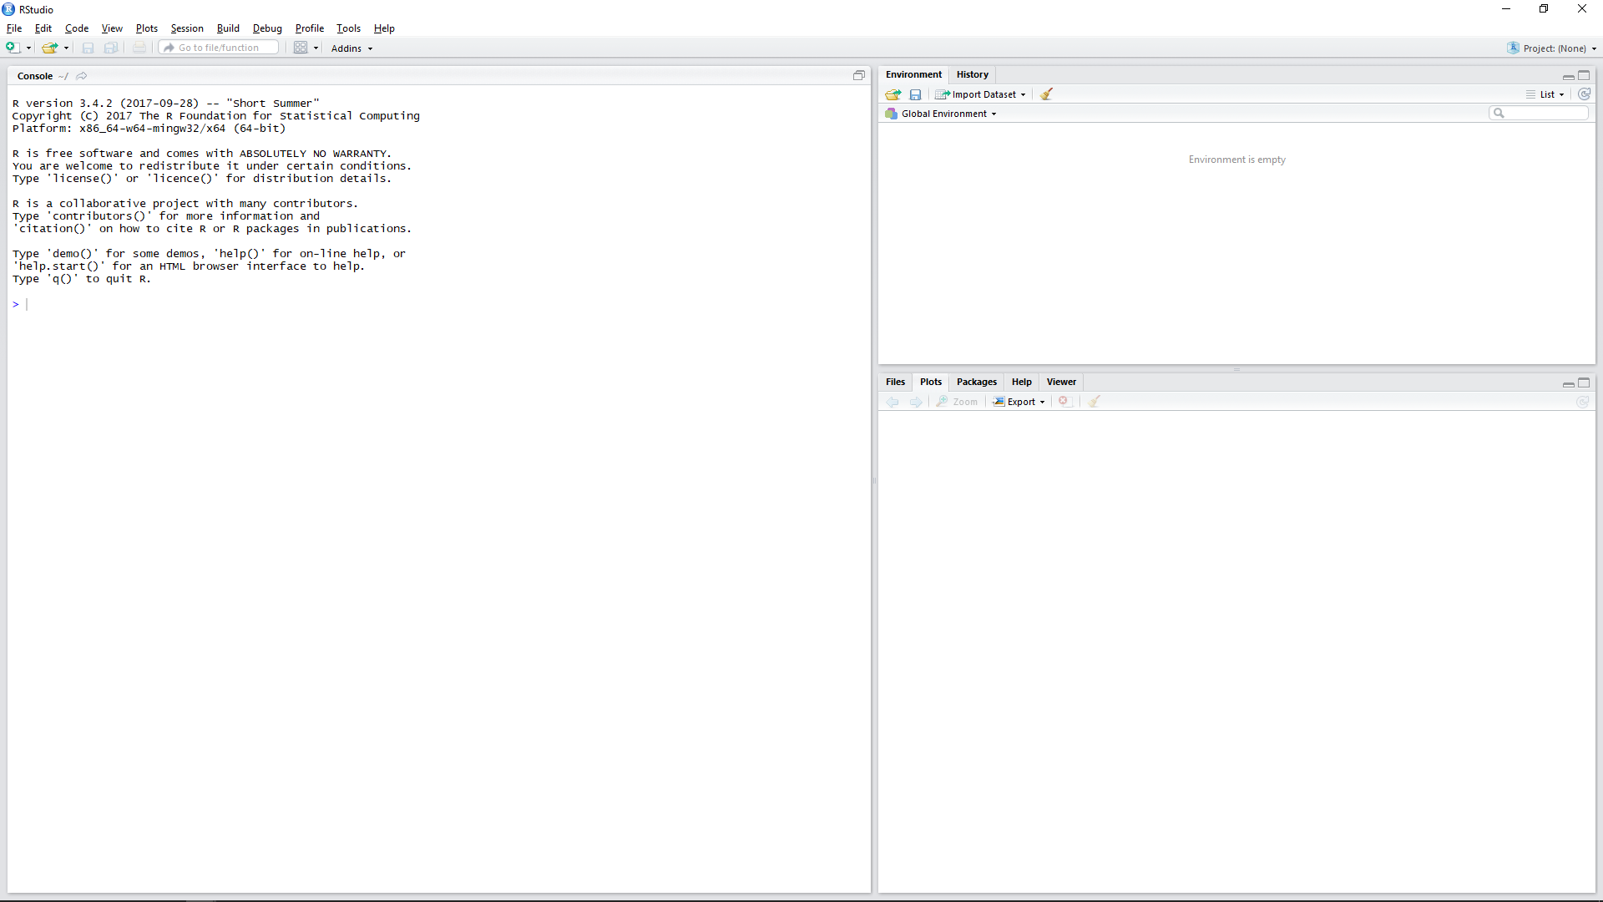
Import Data into R

Slide 20
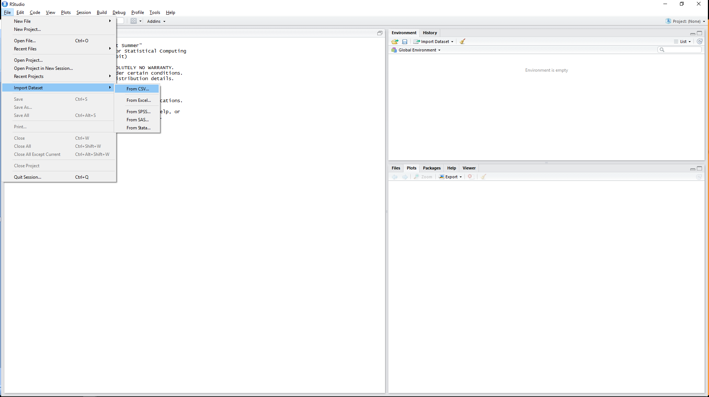
Import Data into R

Slide 21
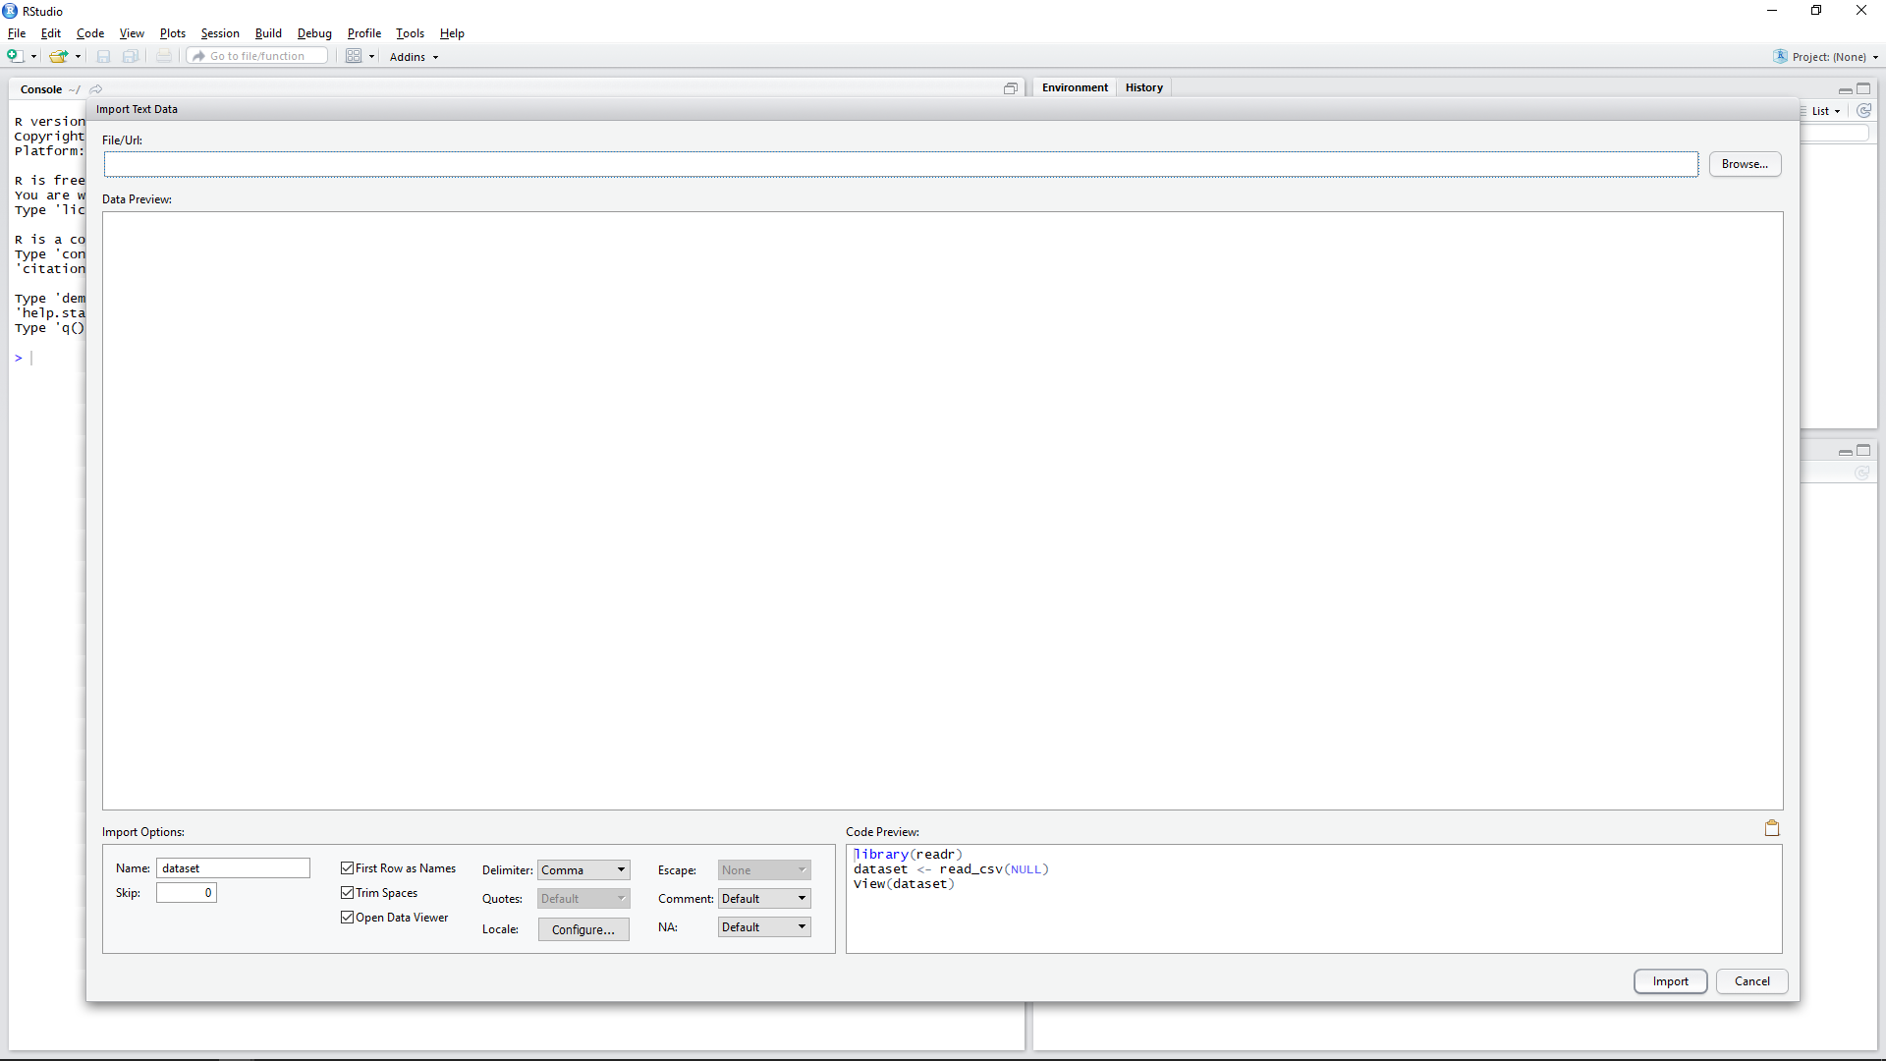
Import Data into R

Slide 22
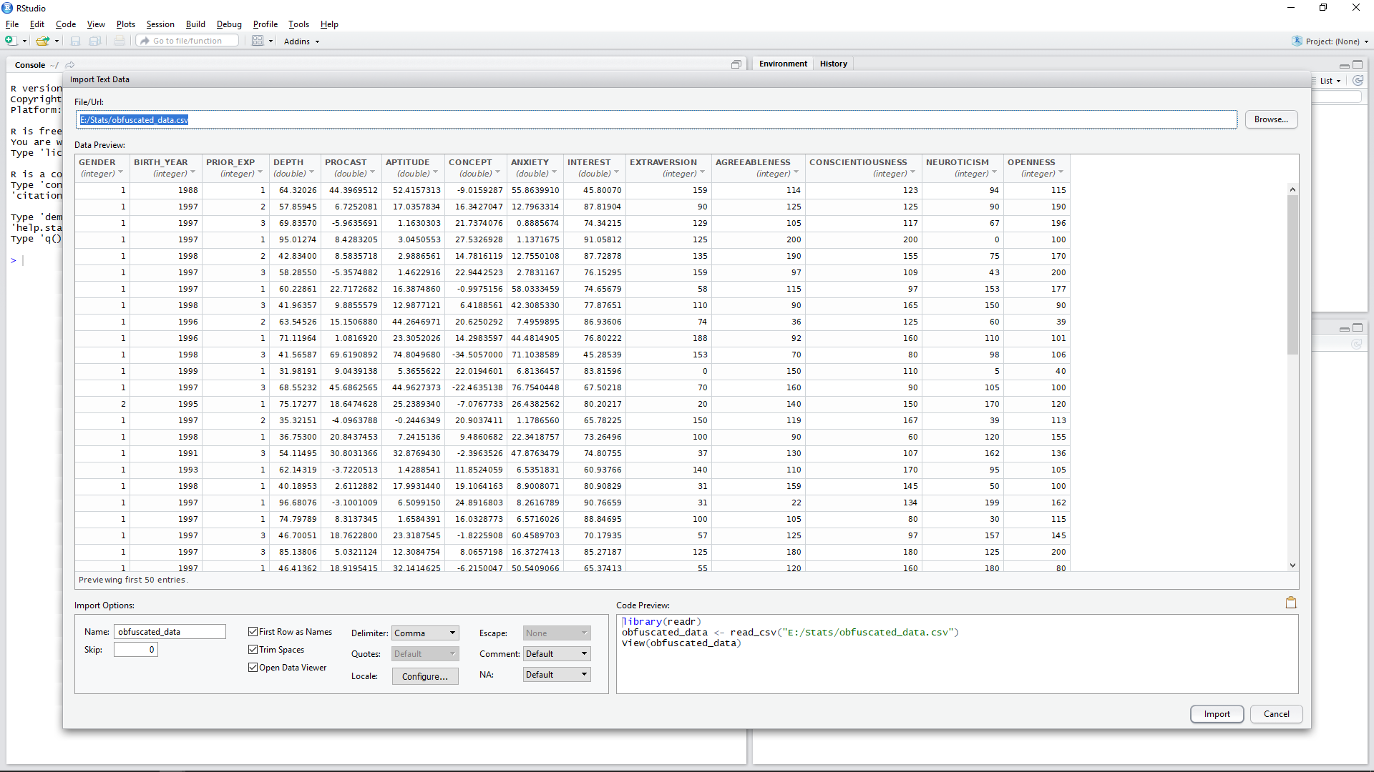
Import Data into R

Slide 23
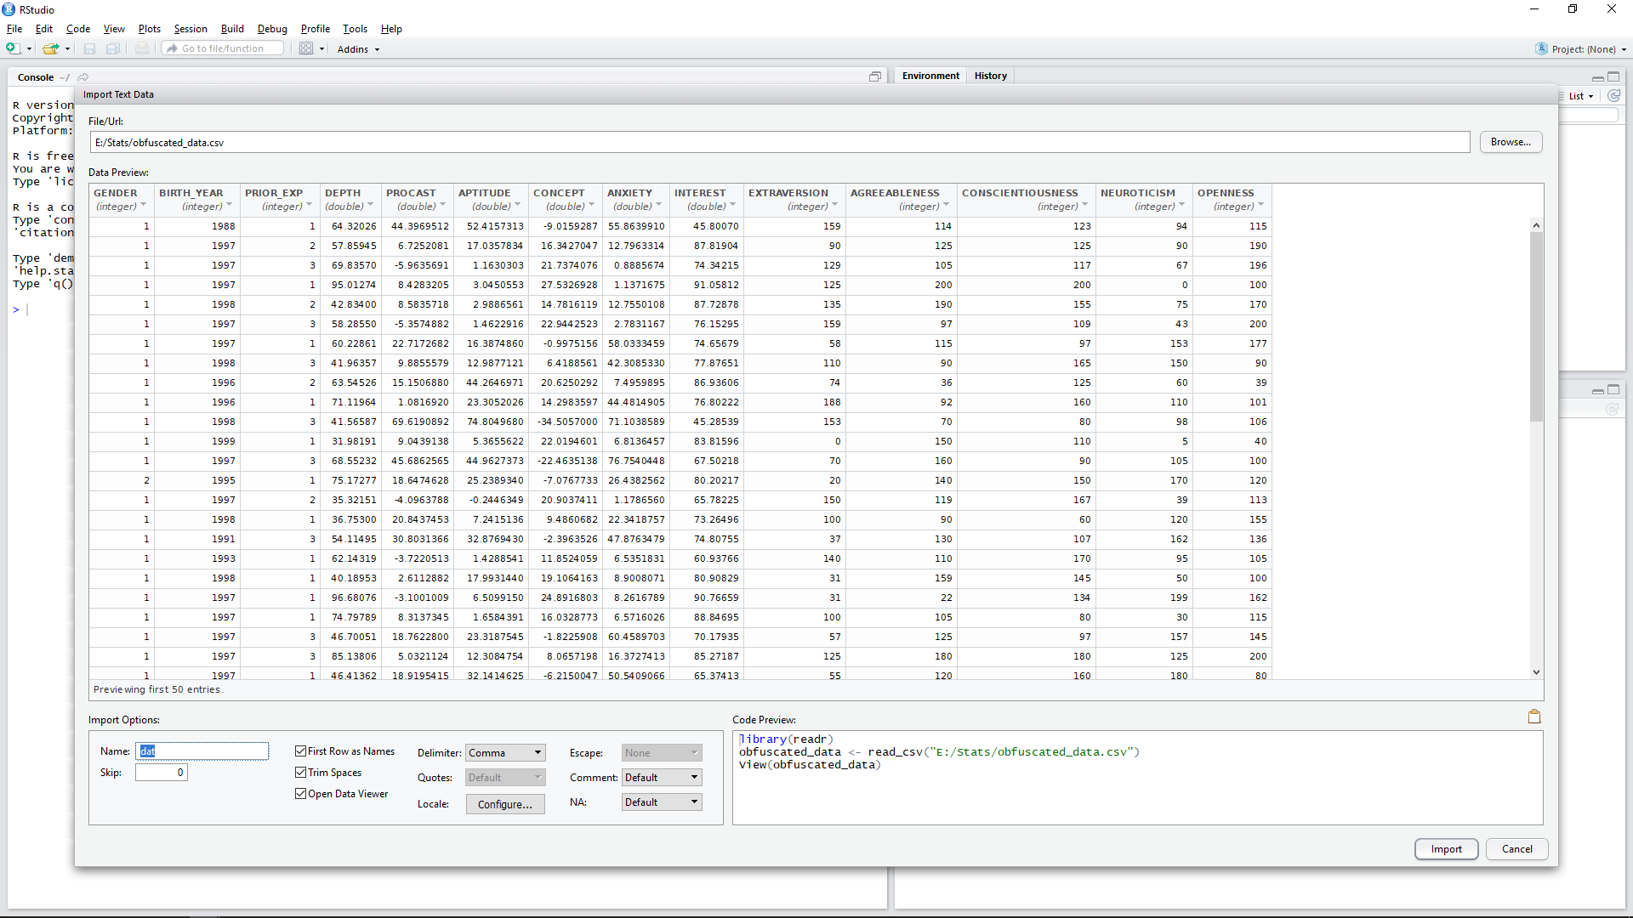
Import Data into R

Slide 24
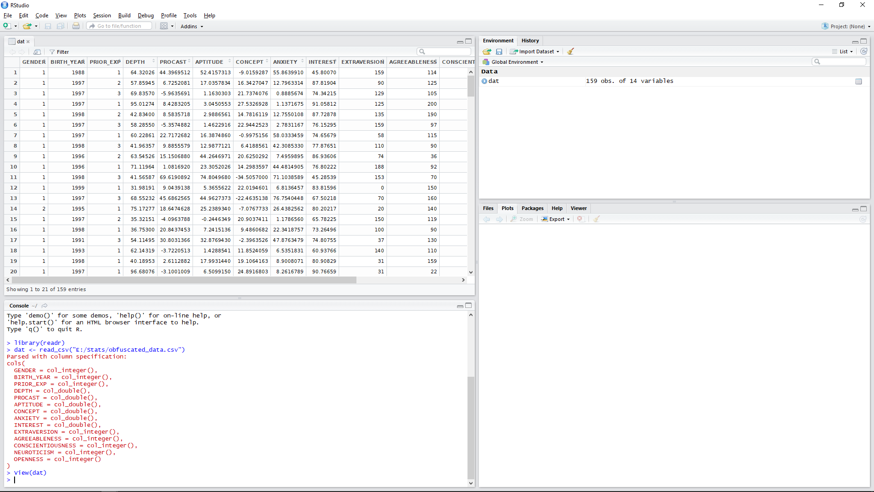
Import Data into R

Slide 25
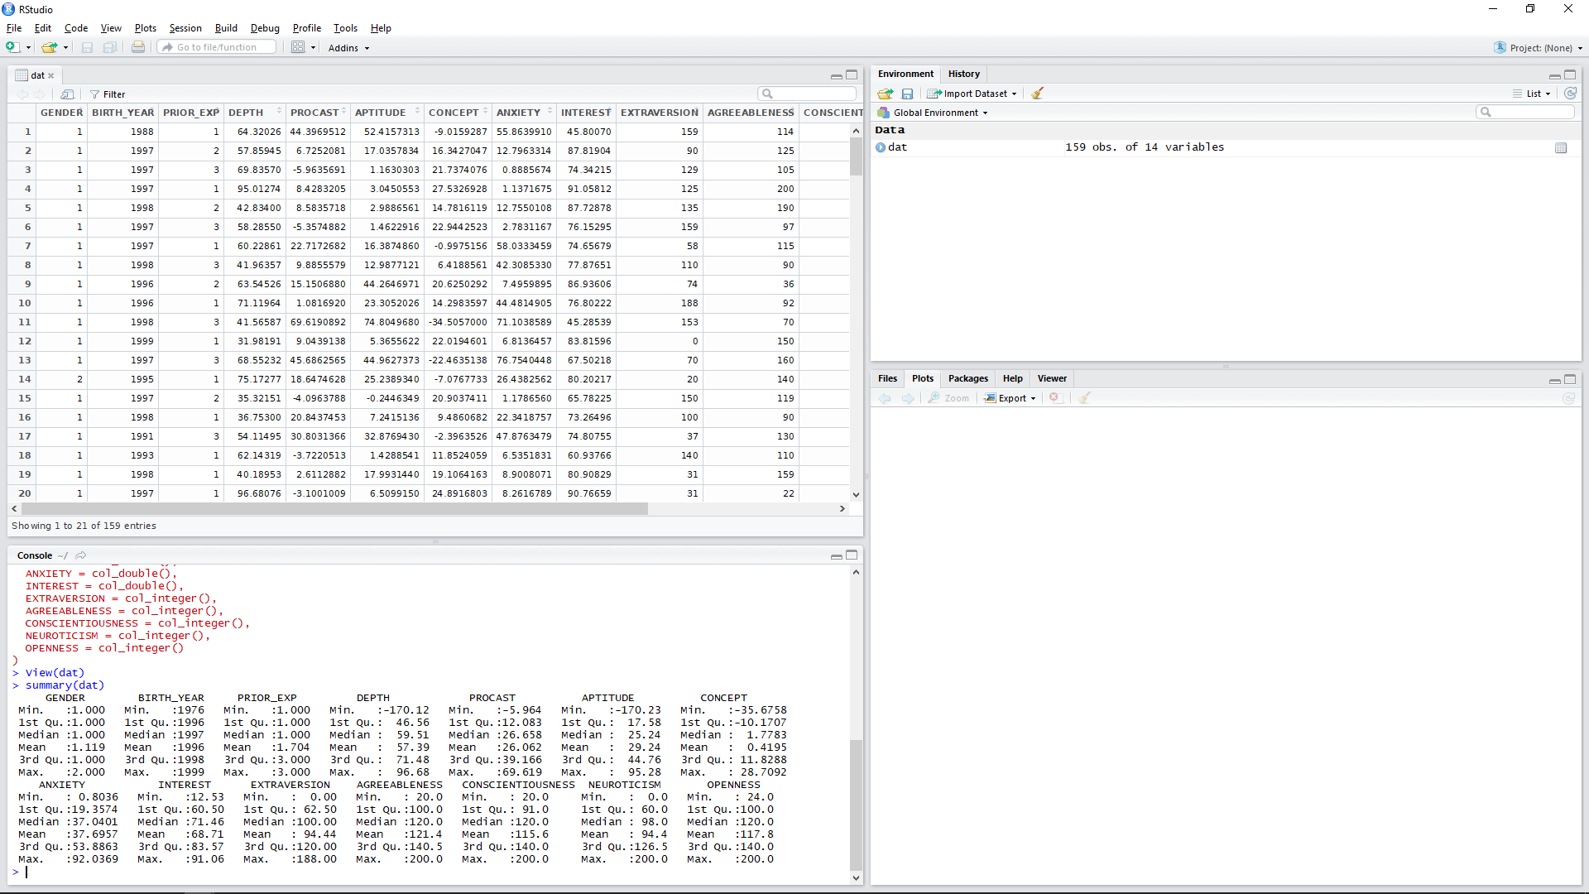
Import Data into R

Slide 26
Data Analysis in R
Illustrating Your Findings

Slide 27
Data Analysis in R
To access a specific variable, use the $ character. It works a bit like the dot operator:
> describe(dat$PROCAST)
Note, some functions such as describe require external libraries to be installed and loaded:
> install.packages(“psych”)
> library(psych)

Slide 28
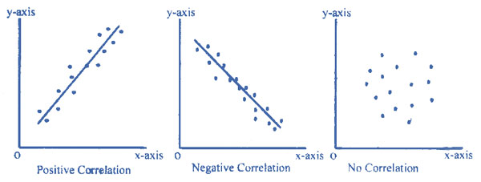
Correlation
Extent to which two continuous variables co-vary (change together)
Ice-cream sales relate to temperature
Waiting time relates to customer satisfaction
Correlations have
Direction
Positive (as the one increases the other variable increases as well)
Negative (as the one increases the other one decreases)
Magnitude – how closely related?

Slide 29
Pearson’s correlation
Provides a numerical measure of the magnitude/direction of the correlation known as r
any value between -1 to +1
-1 (negative), 1 (positive), Close to 0 (no/low)
Pearson r, is a parametric test so assumes both variables
Are continuous
Have an approximately normal distribution

Slide 30
Correlation
To see a correlation:
> cor(x, y)
> cor.test(x, y, method)
Try:
> cor.test(dat$PROCAST, dat$APTITUDE, method=“pearson”)
What does “2.2e-16” mean?
What can we conclude from this data?

Slide 31
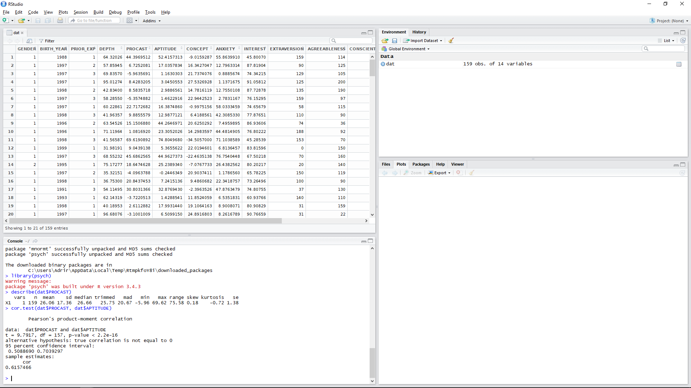
Correlation

Slide 32
Statistical Tests
Enable us to assign a confidence value to an observed relationship or difference between groups or treatment conditions
This is what statisticians call significance level (or sometimes alpha α)
Significance is the probability (p) that observations as extreme or more extreme were made under the assumption that the null hypothesis is true
A lower significance value implies a lower probability that the result is within expected variance assuming the null hypothesis is true

Slide 33
Statistical tests
Significance depends on various factors:
Size of difference / degree of relationship
Degree of variability or dispersion within the sample(s)
Size of the sample
Conventionally p = 0.05 is used as the threshold of significance
Means 1 in 20 chance that observed difference/relationship is not real
Lower values → better (e.g. p = 0.01, p = 0.001)
Threshold should be lowered if you are computing many tests on the same data because chance of false positive increases

Slide 34
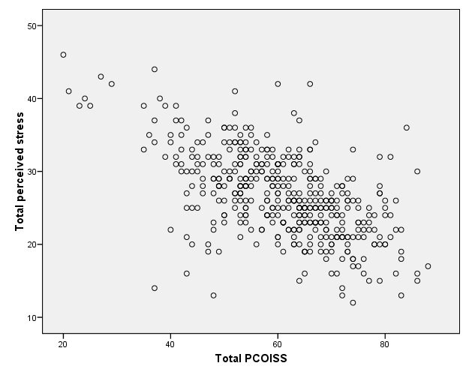
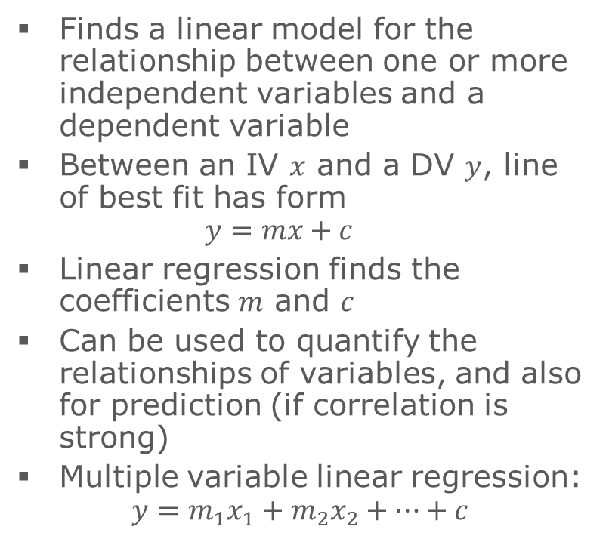
Linear regression
Finds a linear model for the relationship between one or more independent variables and a dependent variable
Between an IV $x$ and a DV $y$, line of best fit has form $y=mx+c$
Linear regression finds the coefficients $m$ and $c$
Can be used to quantify the relationships of variables, and also for prediction (if correlation is strong)
Multiple variable linear regression: $y=m_{1}x_{1}+m_{2}x_{2}+…+c$

Slide 35
Linear Regression
To regress one independent variable (APTITUDE) against one dependent variable (PROCAST):
> rm <- lm(dat$APTITUDE ~ dat$PROCAST)
To view the analysis use:
> summary(rm)
What does these results suggest?
<- is the assignment operator in R
A formula object

Slide 36
Scatter plots
To plot PROCAST (y-axis) against APTITUDE (x-axis):
> plot(dat$PROCAST, dat$APTITUDE)
To plot a line of best fit (regression line):
> abline(rm)
Equivalent to:
> abline(lm(dat$APTITUDE ~ dat$PROCAST))
More on this next week!

Slide 37
Multiple Regression
To regress two independent variables against one dependent variable:
> rm <- lm(dat$ANXIETY ~ dat$NEUROTICISM + dat$APTITUDE)
To view the analysis use:
> summary(rm)
What does these results suggest?
To investigate relative importance of predictors, use:
> library(relaimpo)
> calc.relimp(rm,type=c("pratt"), rela=TRUE)
What happens if you wrap this with the plot() function?
A formula object
+ denotes multiple IVs, not numerical addition!

Slide 38
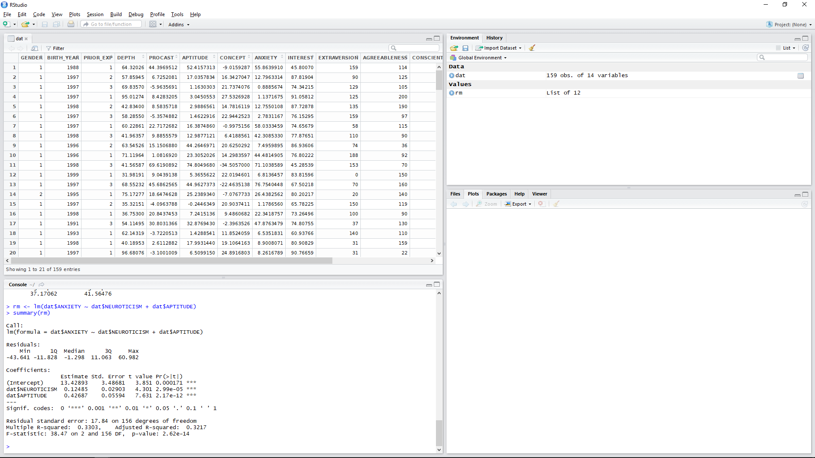
Multiple Regression

Slide 39
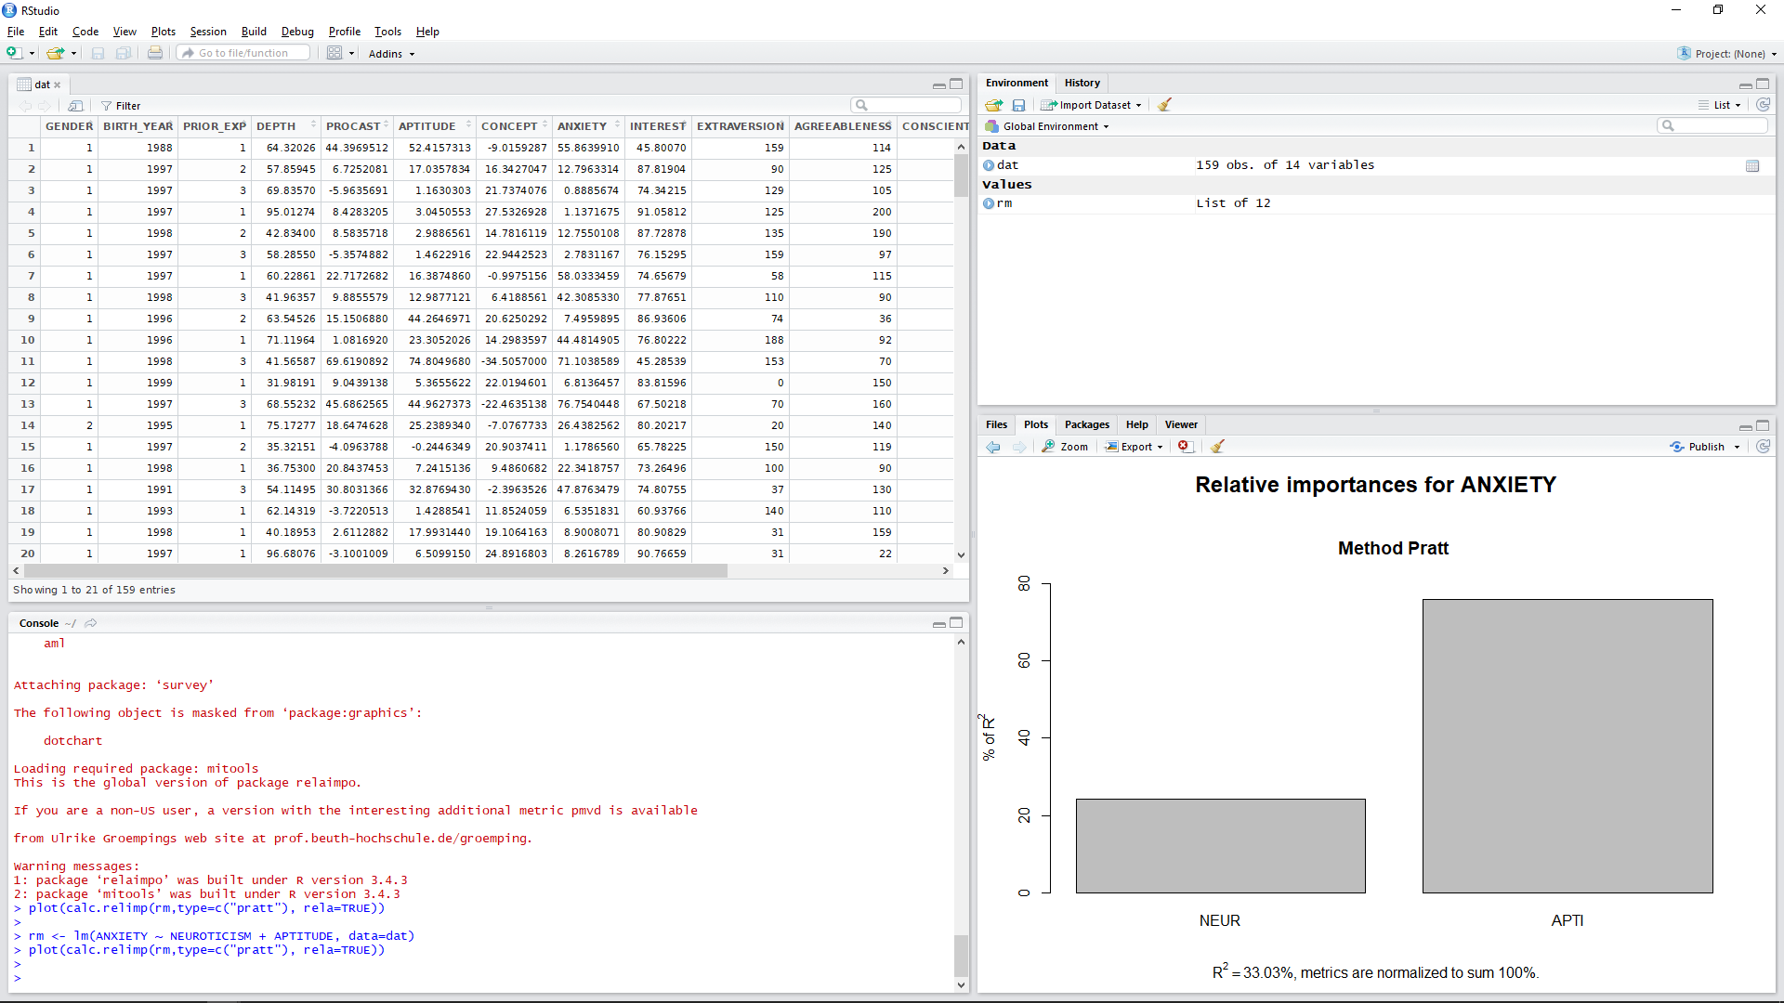
Multiple Regression

Slide 40
T-Test
To see a correlation:
> t.test(x~y)
Note: Data must be in long-format. The tilde indicates the grouping variable.
Try:
> t.test(dat$ANXIETY~dat$GENDER)
What can we conclude from this data?

Slide 41
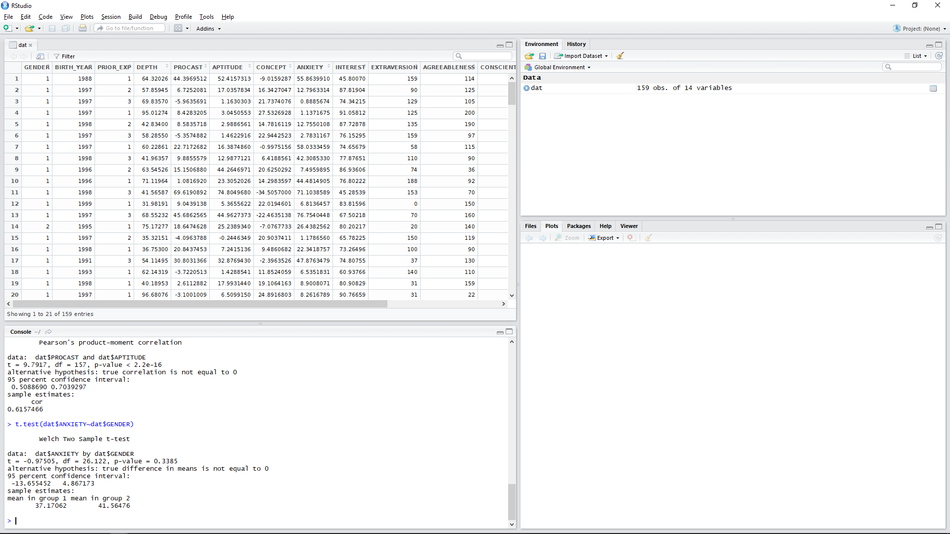
T-Test

Slide 42
Other Analyses
There is a whole host of analyses that can be conducted in Rstudio!
Investigate for yourself those which will have relevance to your particular project.
For resources, see:
www.rdocumentation.org
www.statmethods.net
http://tutorials.iq.harvard.edu/R/
https://support.rstudio.com/hc/en-us

